Slide 1
JAM SLAM
The game

Slide 2

A world of Smoothie
Game concept

Slide 3
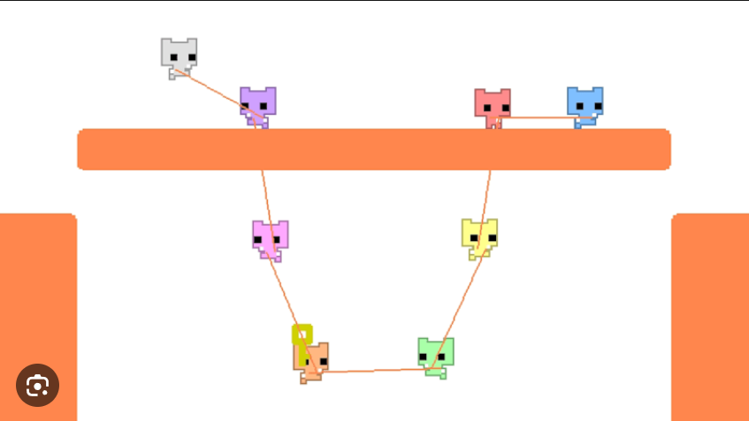
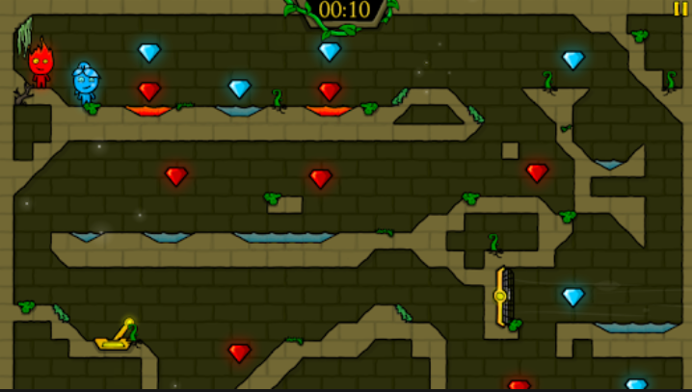
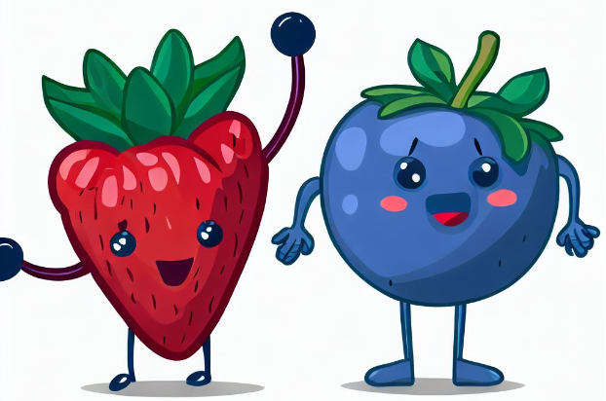

Slide 4






JAM SLAM
Mechanics
Player 1
Player 2

Slide 5


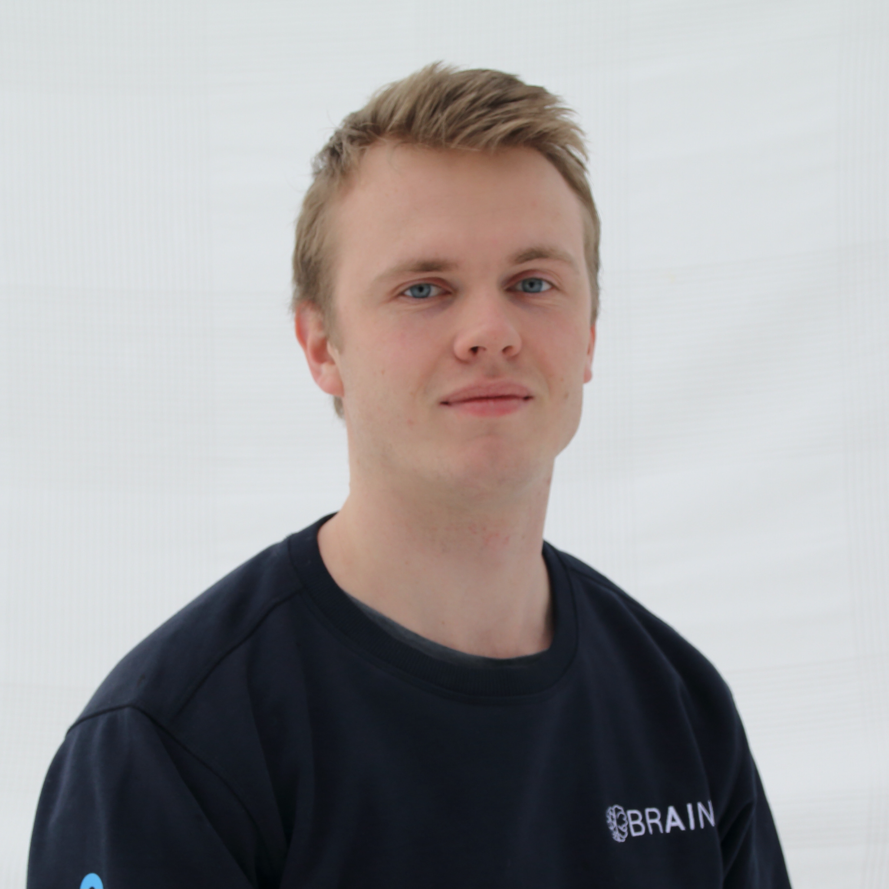
JAM SLAM
The team
Terrence Lead Designer
Erin Lead Developer
Morten Lead Level Designer

